Slide 1
Data storage overview
Data elements can be numbers, characters, logical states of true or false, or even other MATLAB structure types.
MATLAB uses these two-dimensional matrices to store single numbers and linear series of numbers as well. In these cases,
the dimensions are 1-by-1 and 1-by-n respectively, where n is the length of the numeric series.
MATLAB also supports data structures that have more than two dimensions.
These data structures are referred to as arrays in the MATLAB documentation.
MATLAB is a matrix-based computing environment.
All of the data that you enter into MATLAB is stored in the form of a matrix or a multidimensional array.
Even a single numeric value like 100 is stored as a matrix (in this case, a matrix having dimensions 1-by-1):
A = 100;
>>whos A
Name Size Bytes Class
A 1x1 8 double array
Tag:
data storage
Regardless of the class being used, whether it is numeric, character, or logical true or false data,
MATLAB stores this data in matrix (or array) form.
For example,'Hello World' is a 1-by-11 matrix of individual character elements in MATLAB.
You can also build matrices composed of more complex classes, such as MATLAB structures and cell arrays
Matlab does not require any type declarations or dimension statements. When Matlab encounters a new variable name ,it automatically creates
the variable and allocates the appropriate amount of storage. If the variable already exists, Matlab changes it’s content.
Default data type is double precision floating point (64-bit).

Slide 2
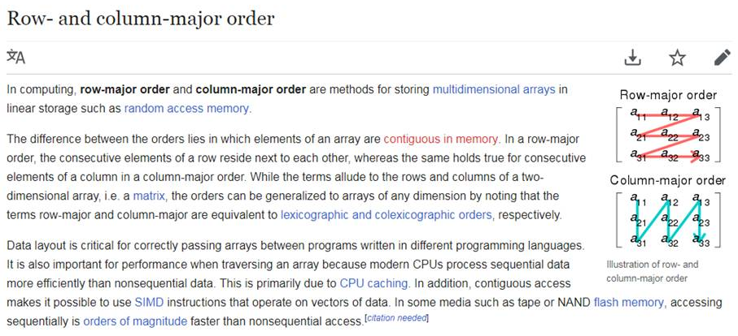
Data storage overview IV Matlab is column major
Tag:
data storage
column major

Slide 3
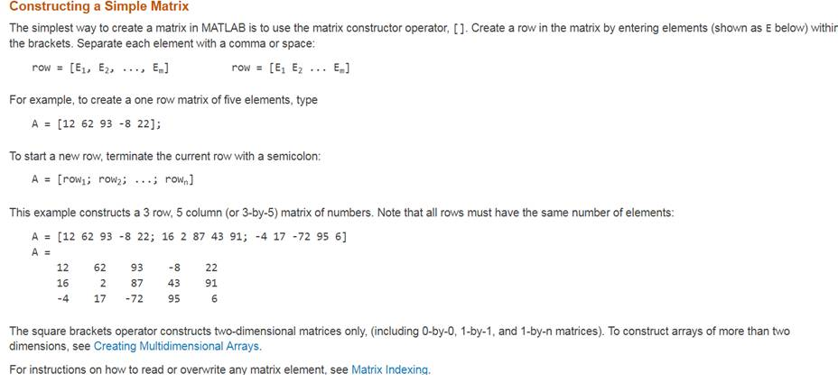
Constructing a Simple Matrix https://www.mathworks.com/help/matlab/math/creating-and-concatenating-matrices.html#responsive_offcanvas
Tag:
matrix construction

Slide 4
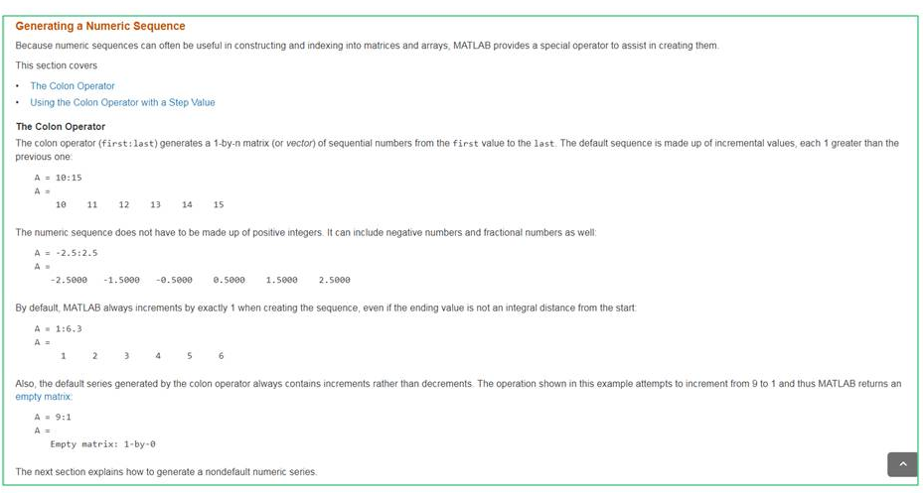
Generating a Numeric Sequence https://www.mathworks.com/help/matlab/math/creating-and-concatenating-matrices.html#responsive_offcanvas
Tag:
colon operator

Slide 5
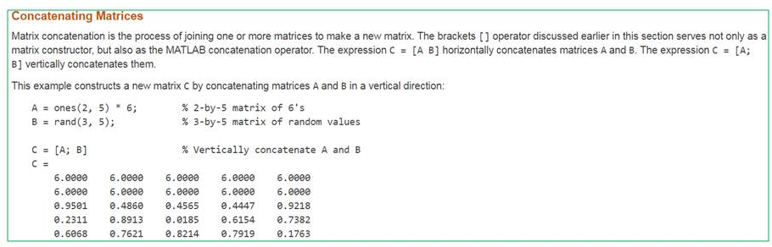
Concatenating Matrices vertically & horizontaly
The brackets [] operator discussed earlier in this section serves not only as a matrix constructor,
but also as the MATLAB concatenation operator.
The expression C = [A B] horizontally concatenates matrices A and B.
The expression C = [A; B] vertically concatenates them
Tag:
Matrix concatenation

Slide 6
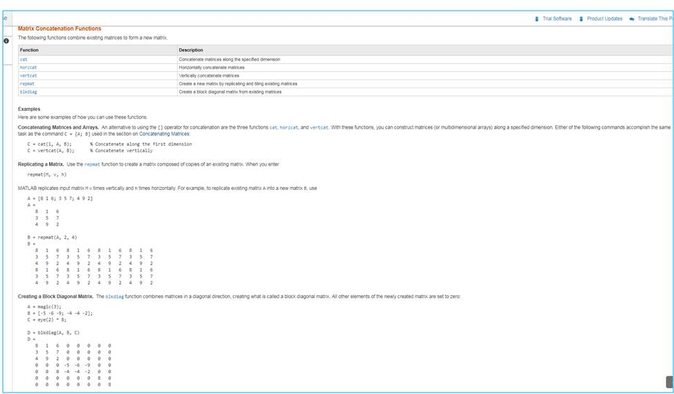
Concatenating Matrices
Tag:
Matrix concatenation

Slide 7
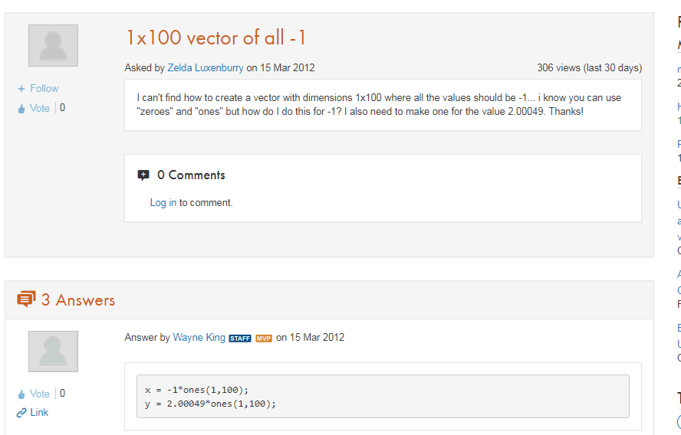
1xnum vector of 1s 2/26/2018
Tag:
ones
zeros

Slide 8
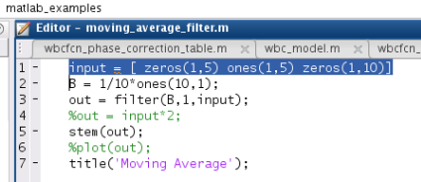
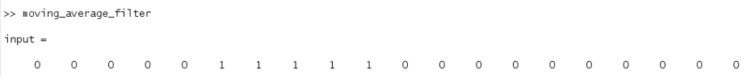
Build a square input pulse 2/26/2018
Tag:
Filter command
Moving average

Slide 9
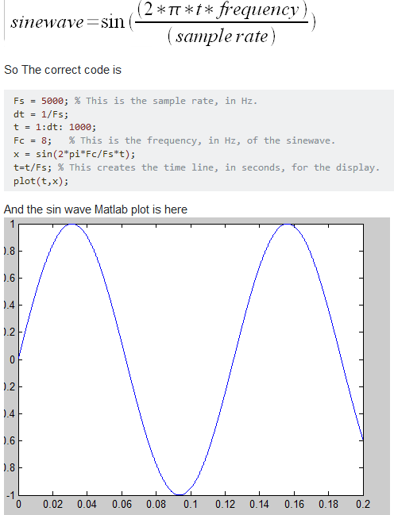
Generate/plot sine wave
sine-wave
Tag:
Plotting
Sine wave syntax

Slide 10
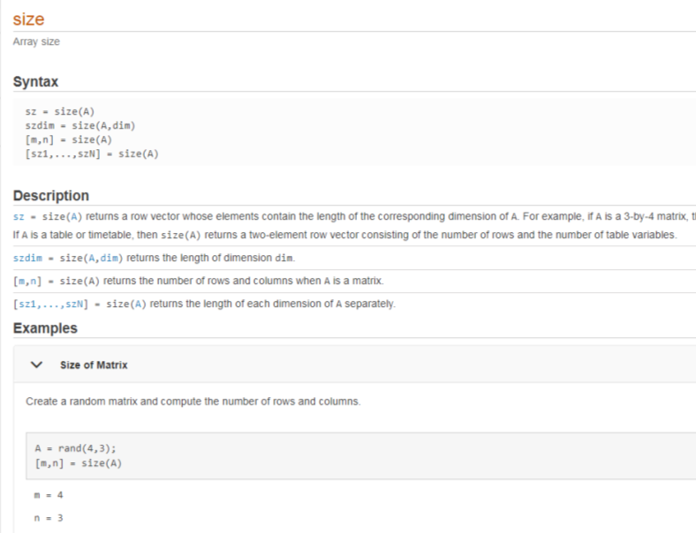
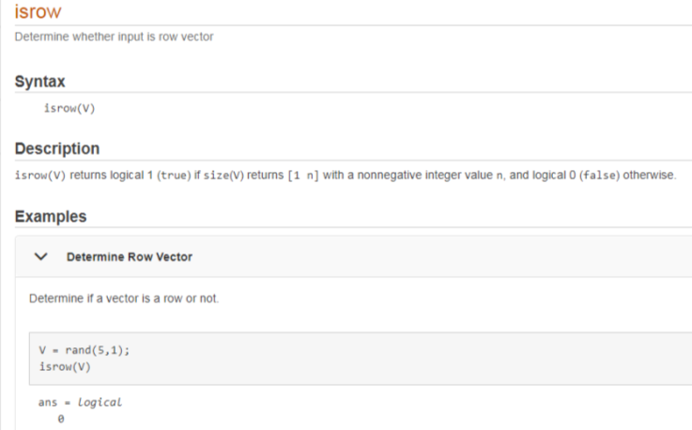
2/28/2018
Get dimensions
Check row or colums
iscolumn
works also!
Tag:
size
isrow
iscolumn

Slide 11
3/8/2018 random beginner stuff
Writes text to console
>>disp(‘something’)
>>fprintf('%s\n',"foobar");
fprintf also used for fileio, pass it a file handle in the first arg
Like this:
A = magic(4);
fileID = fopen('myfile.txt','w');
nbytes = fprintf(fileID,'%5d %5d %5d %5d\n',A)
fprintf Could be used to write out something that would provide communication between Matlab and
Verilog, such as a file that contained parameters.
>>designfilt
runs a filter design wizard
Needs signal processing toolbox
transpose (regular single quote)
>> [1,2]
ans =
1 2
>> [1,2]'
ans =
1
2
Tag:
Filter design
Transpose
File io

Slide 12
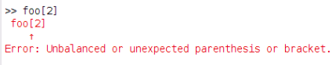
: Colon () NOT [] to access elements
: operator creates a range
>> 1:10
ans =
1 2 3 4 5 6 7 8 9 10
>> 1:2:10
ans =
1 3 5 7 9
Two ways to ge the last column
>> A = [2 3 4 5;6 7 8 9;10 11 12 13;14 15 16 17]
A =
2 3 4 5
6 7 8 9
10 11 12 13
14 15 16 17
>> A(:,4)
ans =
5
9
13
17
>> A(:,end)
ans =
5
9
13
17
: operator by itself refers to all the elements of a row or column
>> A
A =
2 3 4 5
6 7 8 9
10 11 12 13
14 15 16 17
>> A(1,:)
ans =
2 3 4 5
>> A(:,2)
ans =
3
7
11
15
Tag:
Operators
Colon
Access vs definition
end
indicates the
last array index
myarray(m:n) Parenthesis to get slice
>> foo = 1:10
foo =
1 2 3 4 5 6 7 8 9 10
>> foo(2:3)
ans =
2 3
Square brackets don’t work for grabbing a slice!
Use round brackets A(1) to get the first element.
Use square brackets to define a matrix.
A = [1 2];
And yes this in confusing.

Slide 13
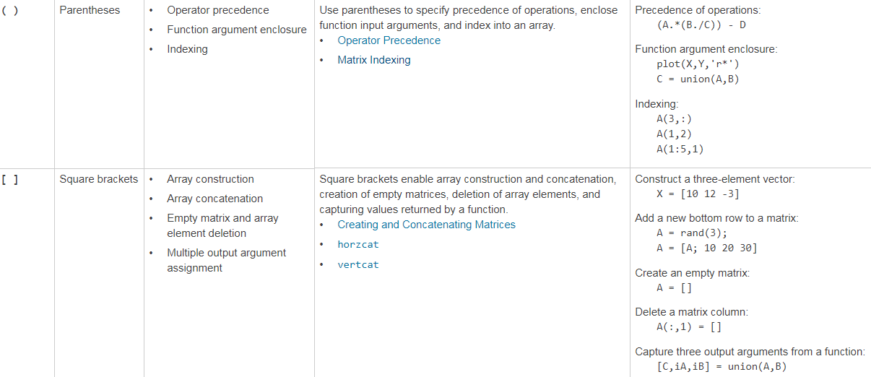
() and [] https://www.mathworks.com/help/matlab/matlab_prog/matlab-operators-and-special-characters.html
Tag:
operators
parenthesis
square brackets

Slide 14
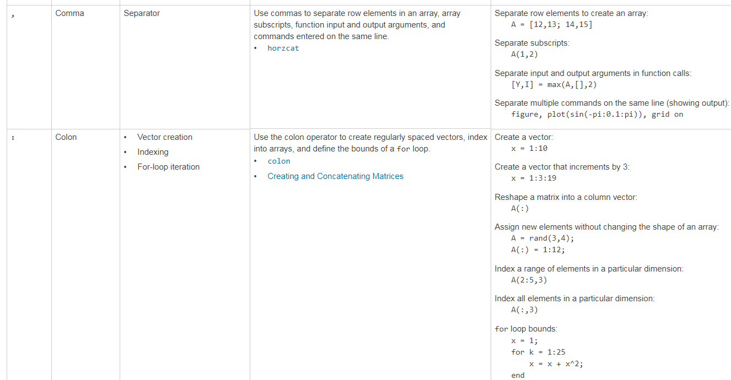
, and ; https://www.mathworks.com/help/matlab/matlab_prog/matlab-operators-and-special-characters.html
Tag:
operators
comma
colon

Slide 15
4/6/2018 Generate uniformly distributed integers
randi function
>> help randi
Pseudorandom integers from a uniform discrete distribution.
R = randi(IMAX,N) returns an N-by-N matrix containing pseudorandom
integer values drawn from the discrete uniform distribution on 1:IMAX.
randi(IMAX,M,N) or randi(IMAX,[M,N]) returns an M-by-N matrix.
Example
>> r = randi(5,1,10)
r =
1 4 5 5 3 3 5 4 1 5
randi function
random constrained integers
>>randi([-5 18], 1, 7) ans = -5 8 1 18 17 3 14
Tag:
random

Slide 16
4/17/2018 Various Notes
Run shell script
Execute a highlighted region
- Highlight a region, F9
Don’s
forget
These
Set Breakpoint
Click in the LH margin near the -
Example of write to a file
phase_correction_table.m
Tag:
keyboard shortcuts
Breakpoint
run shell script
Function round2ev is bankers rounding
Run a block of code (between double %%)
C-<enter>

Slide 17
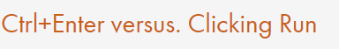
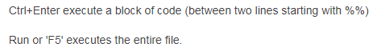
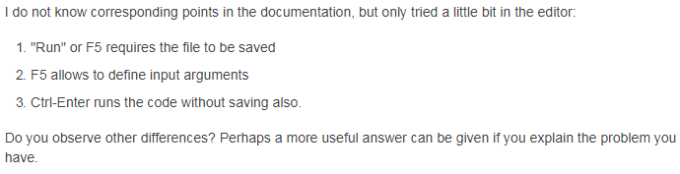
4/17/2018 Various Notes II
C-Enter to run a “Cell”
hmmm what is a cell
Tag:
cntl + enter

Slide 18
4/17/2018 Various Notes III
Transpose Notes
transpose is ‘
transpose of a complex is .’
regular
Tag:
transpose
operators

Slide 19
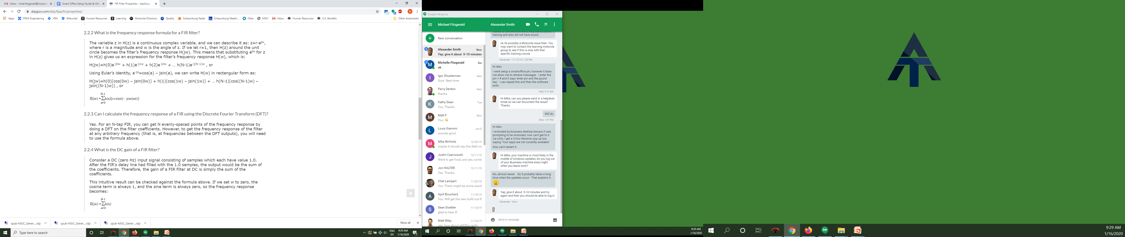
Interesting comment from DSP Guru don’t know where to put it right now
To get the dc gain of a filter, sum the coefficients
Below here
Tag:
dc gain

Slide 20
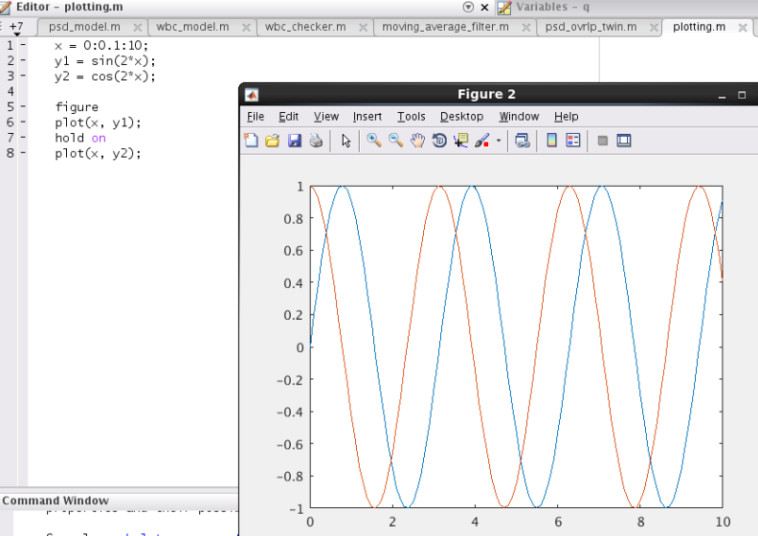
Two plots overlaid on one
Tag:
plotting

Slide 21
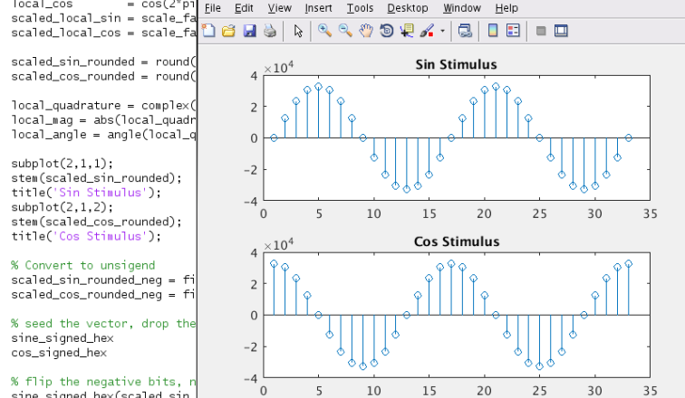
Two fns, one figure separately link to Matlab Help Page for this
1st
plot
The first
two arguments
to subplot()
are the grid size.
The third arg is which
one to use for the current plot
2nd
plot
Tag:
plotting

Slide 22
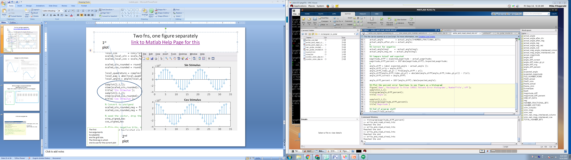
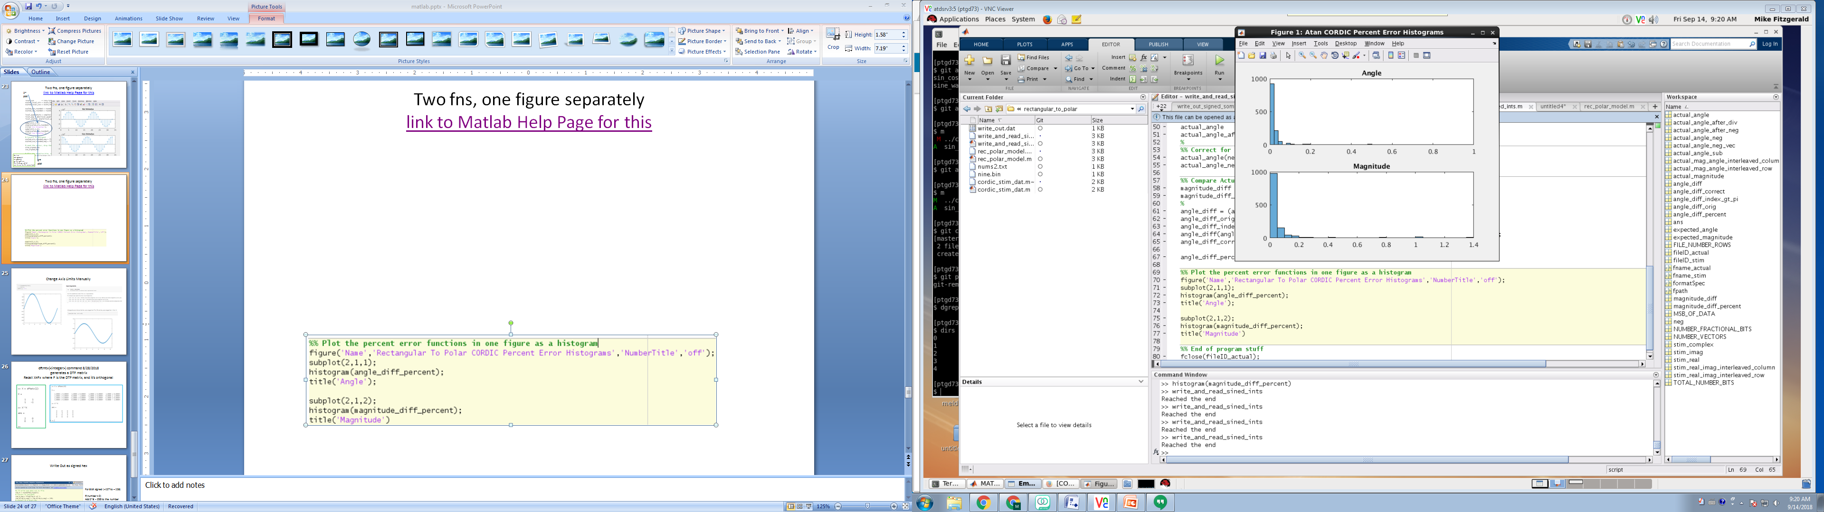
Two fns, one figure separately Maybe a better example, this time it’s two histograms link to Matlab Help Page for this
Tag:
plotting
subplot

Slide 23
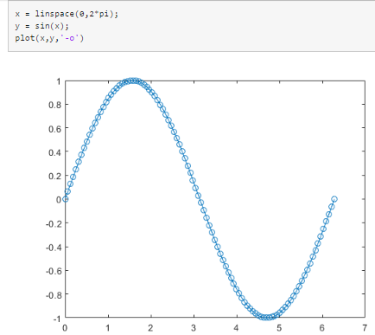
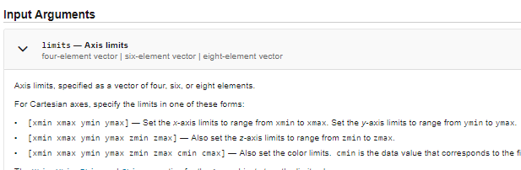
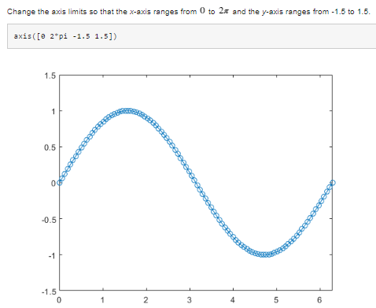
Change Axis Limits Manually
Tag:
plotting
axis limits

Slide 24
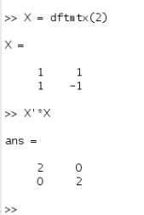
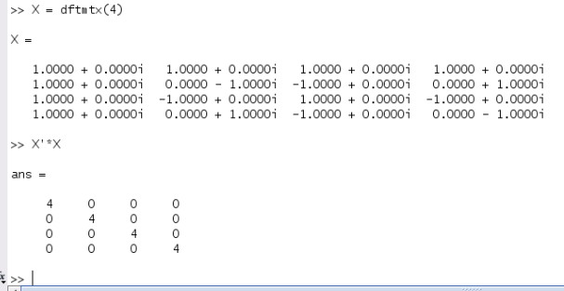
dftmtx(<integer>) command 8/28/2018 generates a DTF matrix Recall X=Fx where F is the DTF matrix, and it’s orthogonal
Tag:
dftmtx command

Slide 25
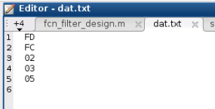
Simple write vector to file as a column of signed hex
a = [253 252 2 3 5];
a_hex = dec2hex(a);
[rows columns] = size(a_hex);
fid = fopen('dat.txt','w');
for i=1:rows
fprintf(fid,'%s\r\n',a_hex(i,:) );
End
fclose(fid)
Tag:
file IO
slash r
fclose

Slide 26
Examples
fr_data_out = fft(data_out.*window(window_name,data_samples)',fft_size);
figure;
plot(20*log10(abs(fr_filter(1:fft_size/2))./max(abs(fr_filter))));
hold on;
grid on;
plot(20*log10(abs(fr_data_in(1:fft_size/2))./max(abs(fr_data_in))),'r');
plot(20*log10(abs(fr_data_out(1:fft_size/2))./max(abs(fr_data_out))),'g');
legend('Filter','Data in','Data out');
title('Default filter configuration');
disp('Press any key to continue...'); pause;
fr_data_out2 = fft(data_out2.*window(window_name,data_samples)',fft_size);
figure;
subplot(2,1,1);
plot(20*log10(abs(fr_filter(1:fft_size/2))./max(abs(fr_filter))));
hold on;
grid on;
plot(20*log10(abs(fr_data_in(1:fft_size/2))./max(abs(fr_data_in))),'r');
plot(20*log10(abs(fr_data_out(1:fft_size/2))./max(abs(fr_data_out))),'g');
legend('Filter','Data in','Data out');
title('Default filter');
subplot(2,1,2);
plot(20*log10(abs(fr_filter_rld(1:fft_size/2))./max(abs(fr_filter_rld))));
hold on;
grid on;
plot(20*log10(abs(fr_data_in(1:fft_size/2))./max(abs(fr_data_in))),'r');
plot(20*log10(abs(fr_data_out2(1:fft_size/2))./max(abs(fr_data_out2))),'g');
legend('Filter','Data in','Data out');
title('Reloaded filter');
disp('Press any key to continue...'); pause;

Slide 27
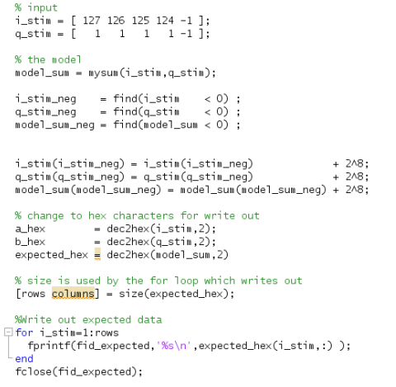
Write Out signed hex more complex
For 8 bit signed (+127 to – 128)
if(number < 0)
Add 2^8 = 256 to the number
Tag:
file io
dec2hex
For loop writes one line
row at a time to a text file
as one line at a time. The
Loop variable is the row

Slide 28
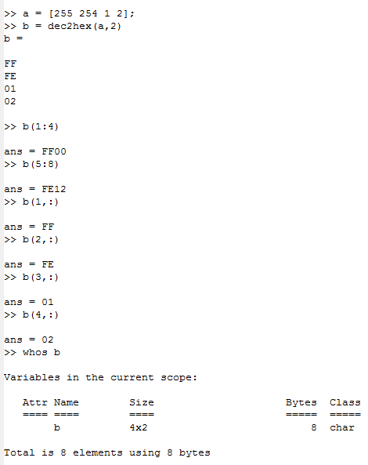
dec2hex returns a ‘character array’
The 2nd arg is the number of hex characters
255 <-> FF
A 4x2 character array
Tag:
file io
character array

Slide 29
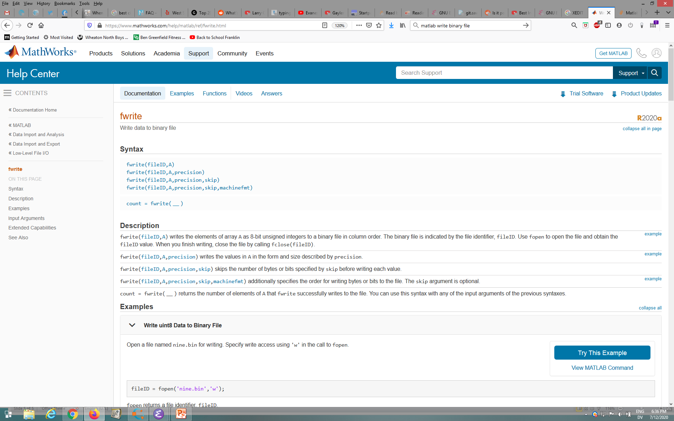
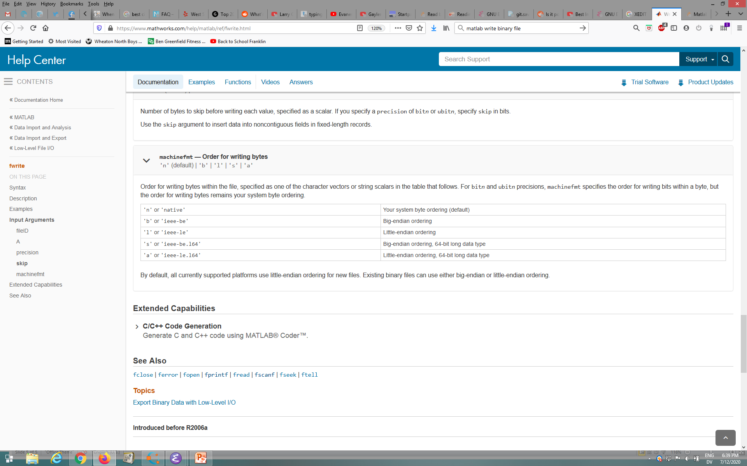
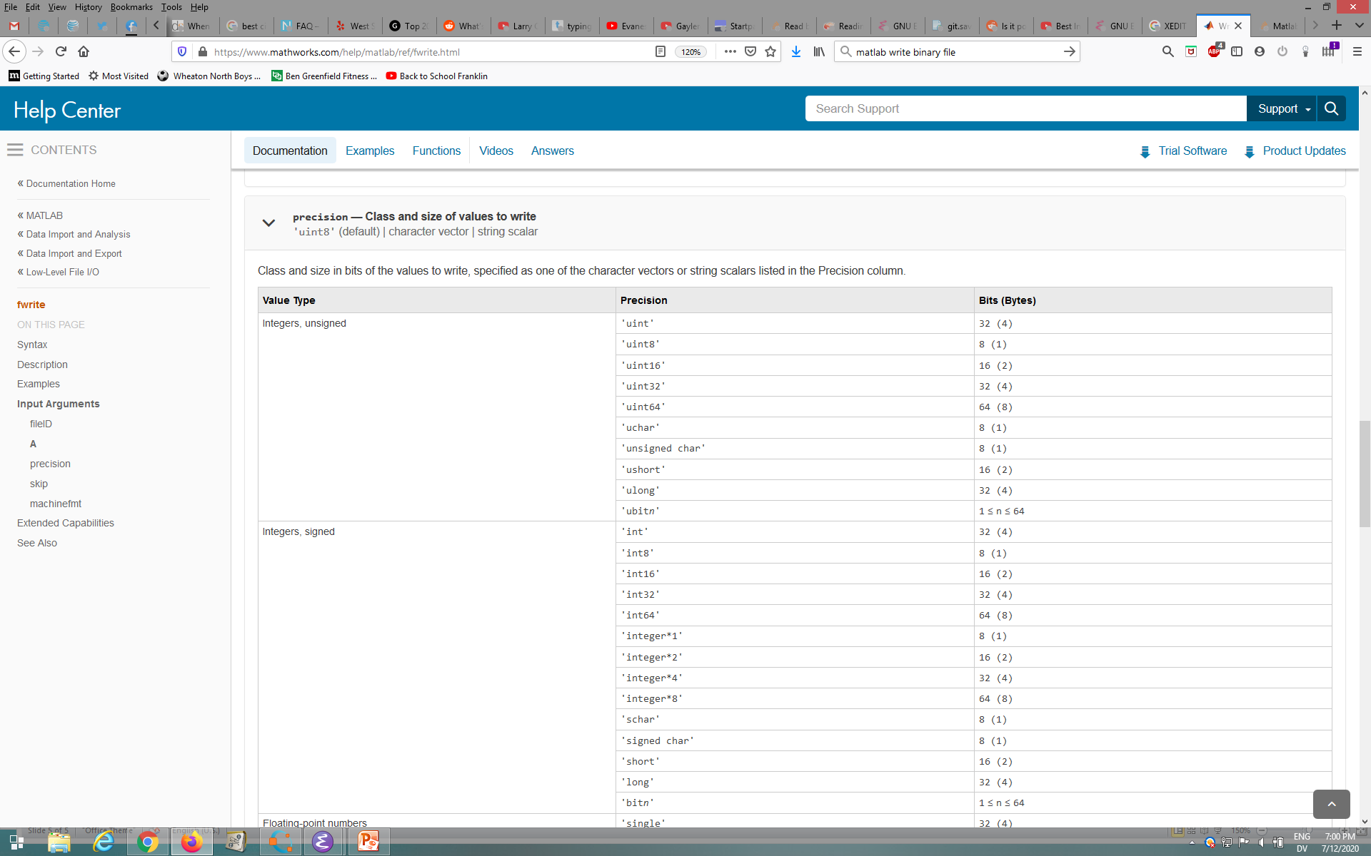
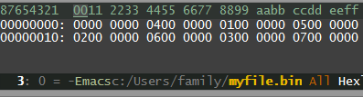
Writing Binary file
https://www.mathworks.com/help/matlab/ref/fwrite.html
a = [ 0 1 2 3; 4 5 6 7];
fileid = fopen('myfile.bin','w');
fwrite(fileid,a,'uint32','ieee-le');
fclose(fileid);
2x4
Not a string.
Easy to make a mistake re what is a string & not. \w the fileio stuff. ☺
Matlab read matrix a and processed (wrote bin file) column major.
first read
second read

Slide 30
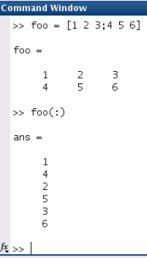
: gives a single column vector from any size matrix
Tag:
colon operator

Slide 31
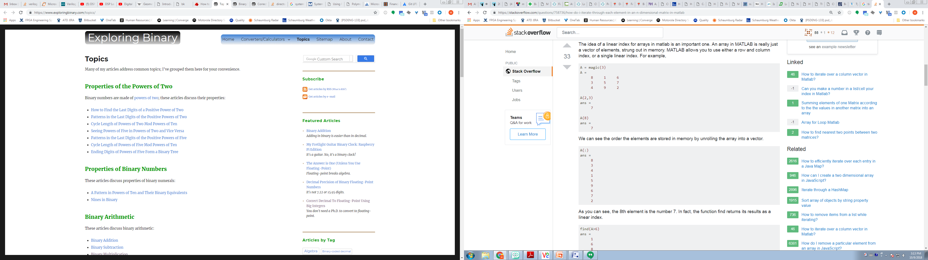
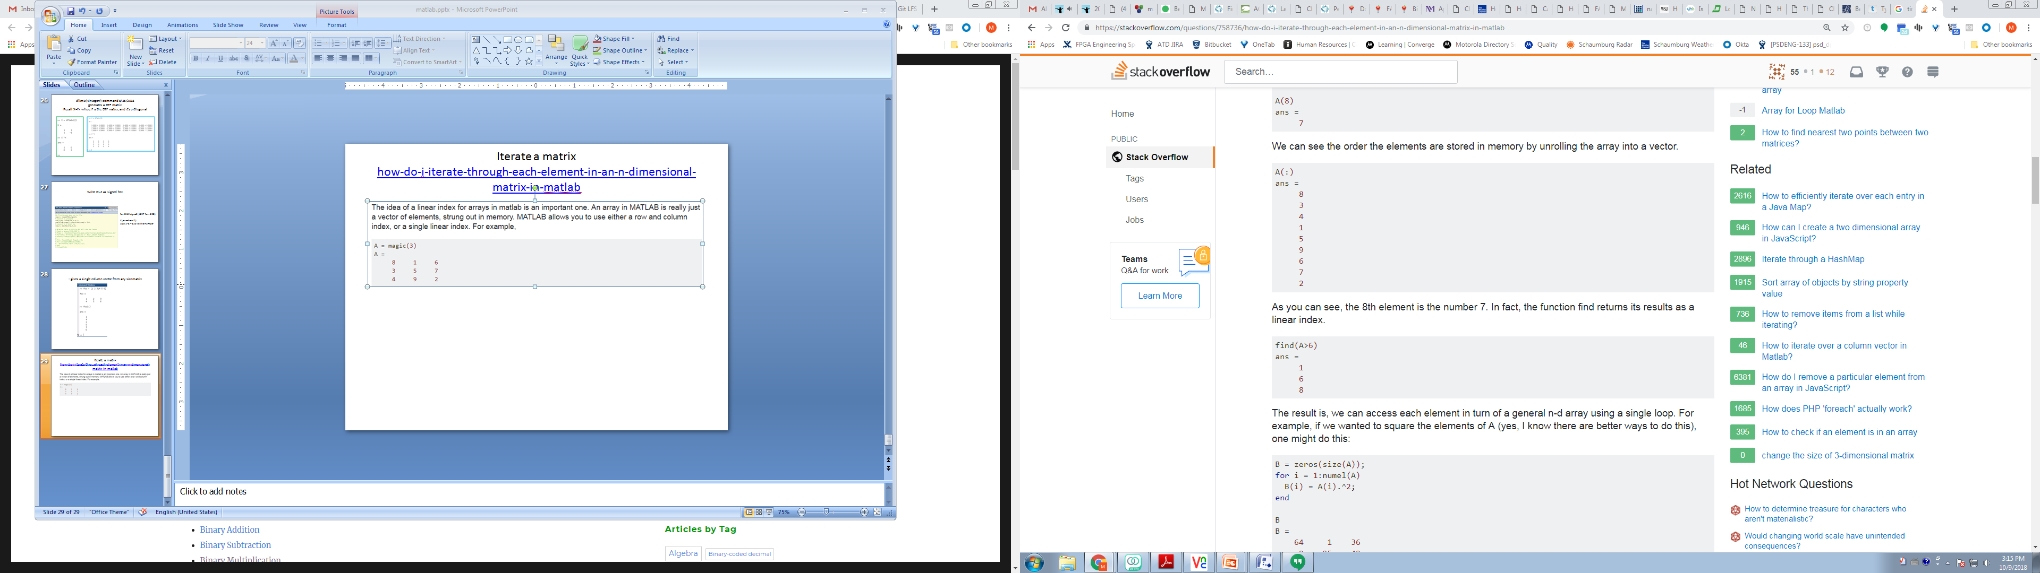
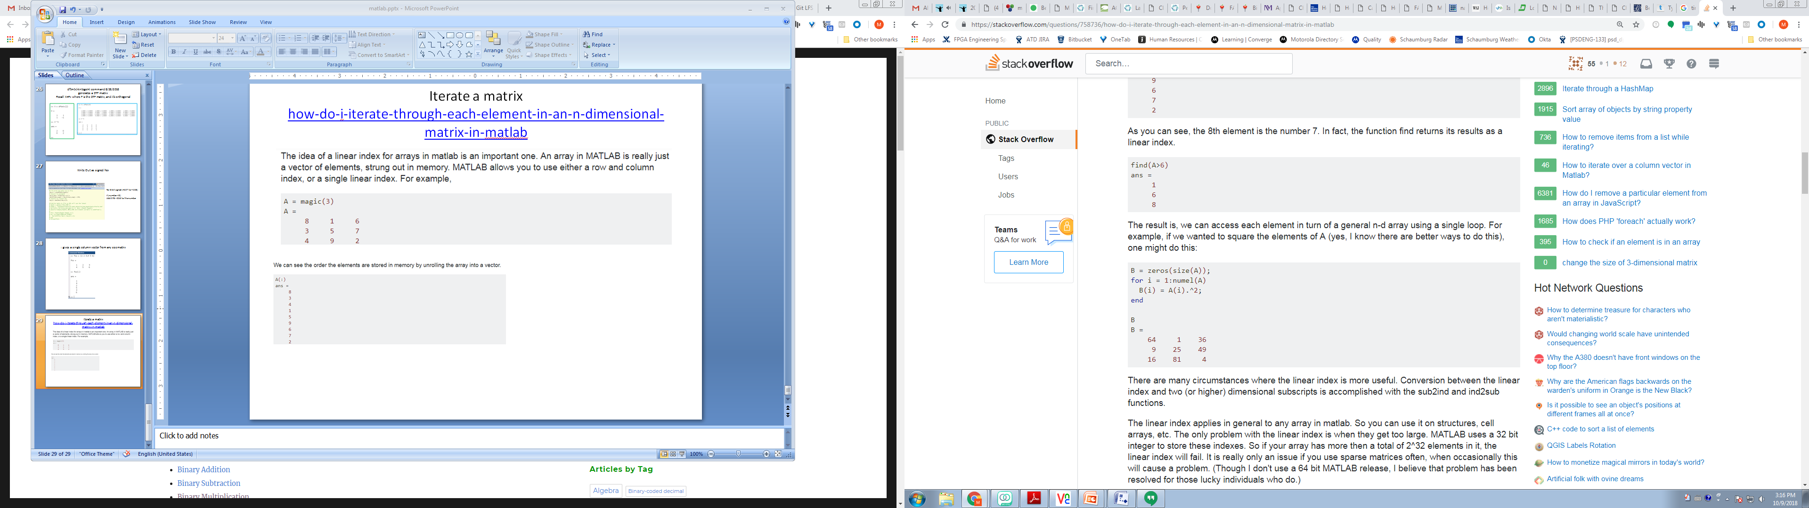
Iterate a matrix how-do-i-iterate-through-each-element-in-an-n-dimensional-matrix-in-matlab
Tag:
matrix iteration
for loop
B = zeros(size(A));
for i = 1:numel(A)
B(i) = A(i).^2;
end
It works without defining
B ahead of time, but it produces
A row vector, rather than a 3x3.
So define B ahead of time to get
the shape you want.

Slide 32
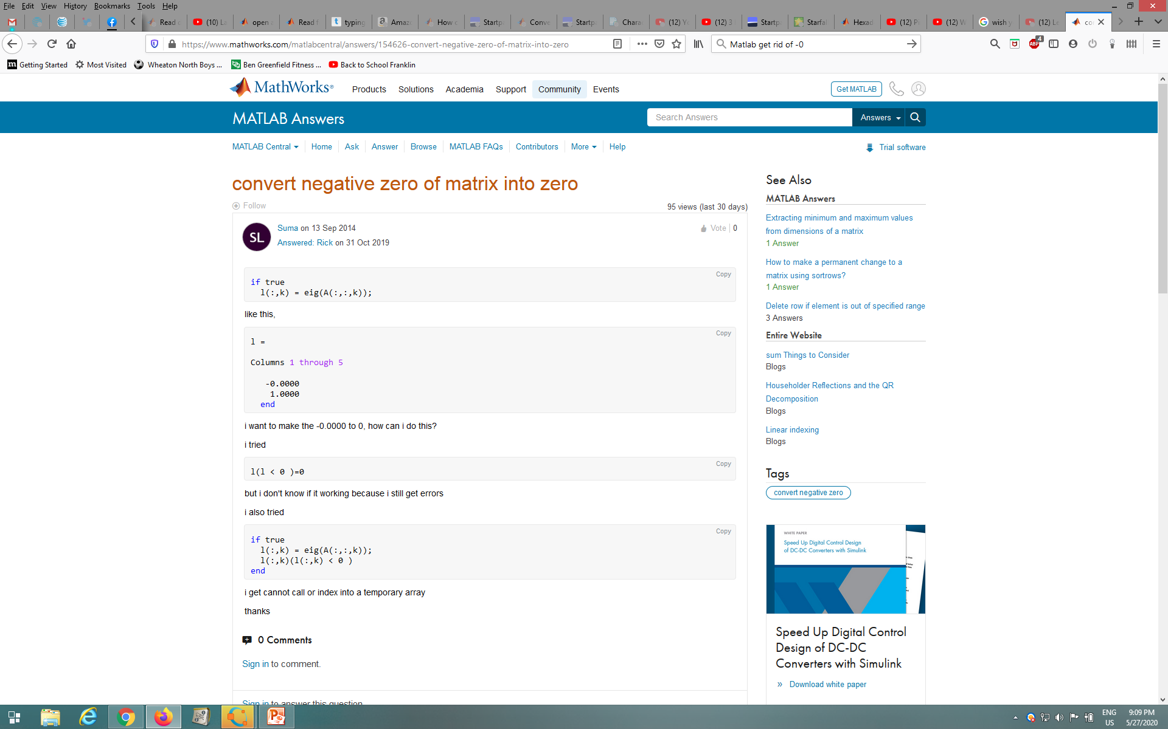
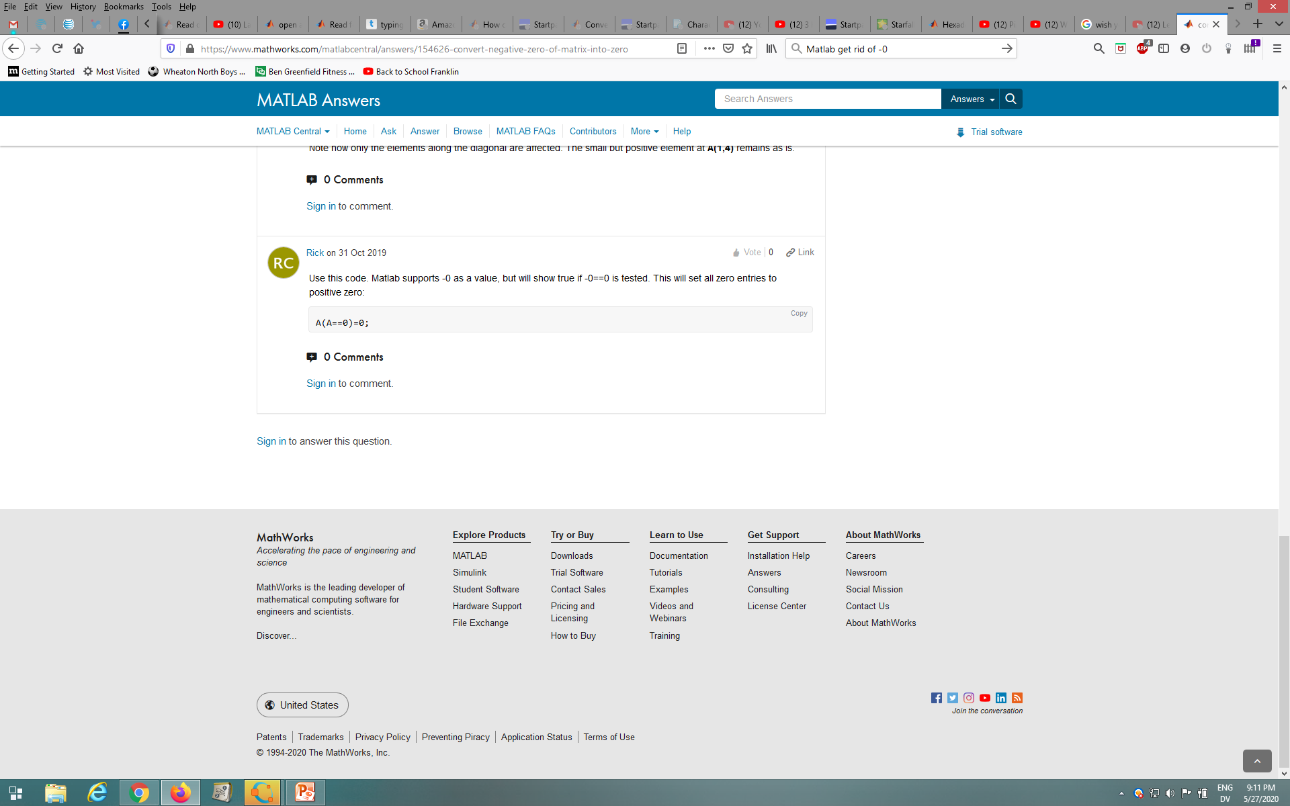
Get rid of -0, happens when rounding
Tag:
Minus zero

Slide 33
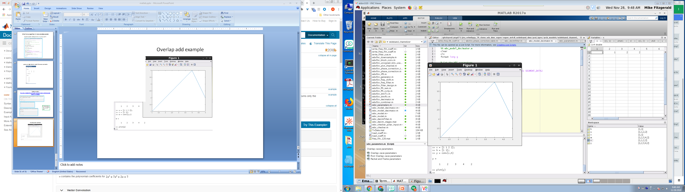
Overlap add example I
Tag:
Overlap add

Slide 34
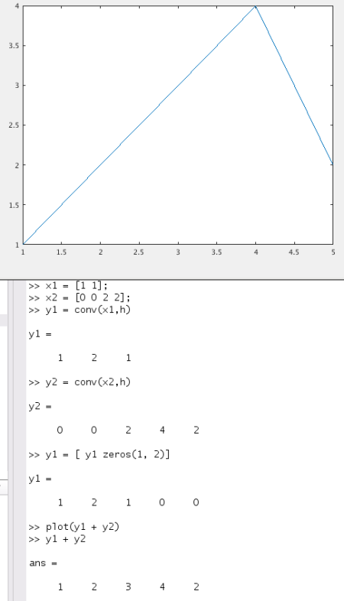
Overlap add example
Separate input into two parts
Input treated as one part
Tag:
Overlap add
The answer [ 1 2 3 4 2] agrees with the same problem’s hand analysis, done on 11/27/2018

Slide 35
Add a path in .m code relative to an environment variable
addpath(fullfile(getenv(‘ENV_VAR'),‘path'))
Tag:
Addpath
Fullfile
getenv

Slide 36
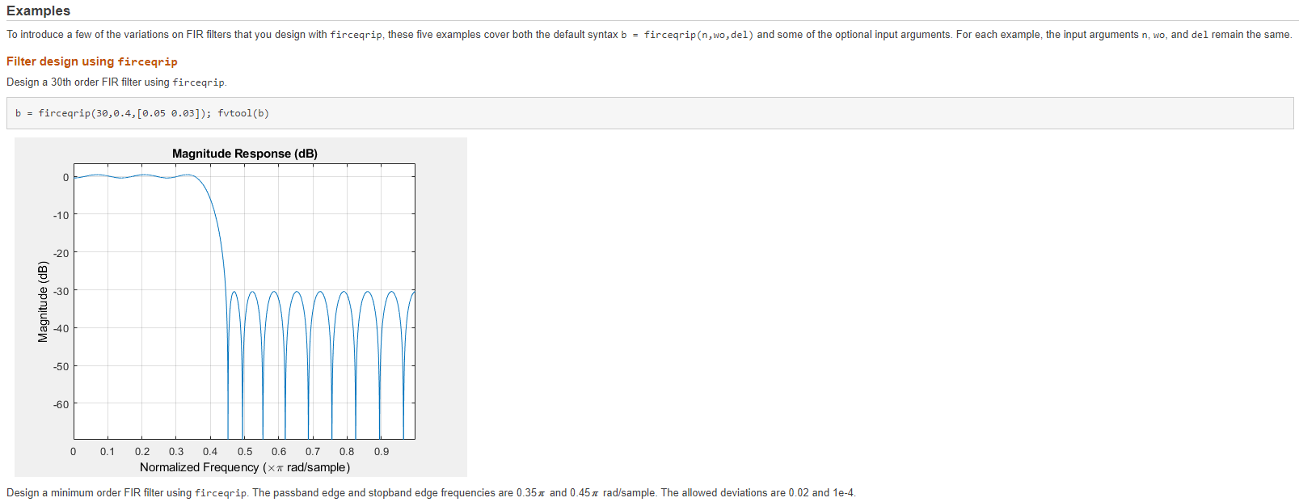
Design a filter with firceqrip Specify attenuations, it gives coefficients https://www.mathworks.com/help/dsp/ref/firceqrip.html
Tag:
Filter design

Slide 37
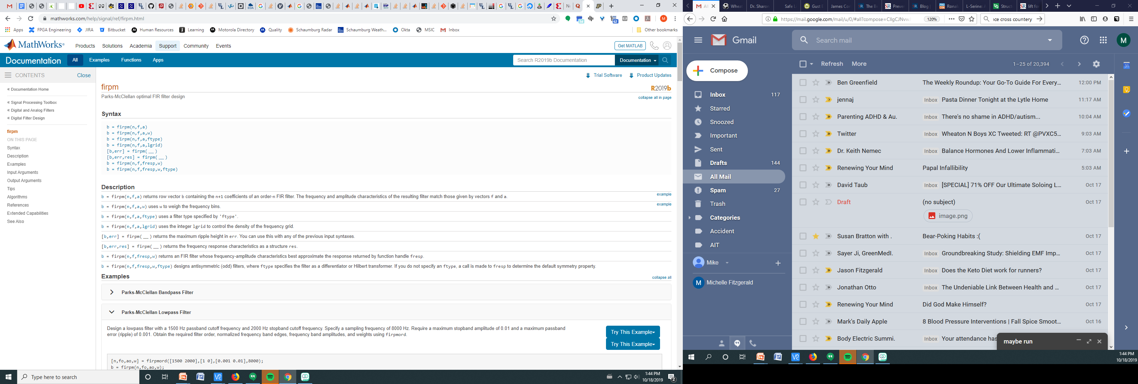
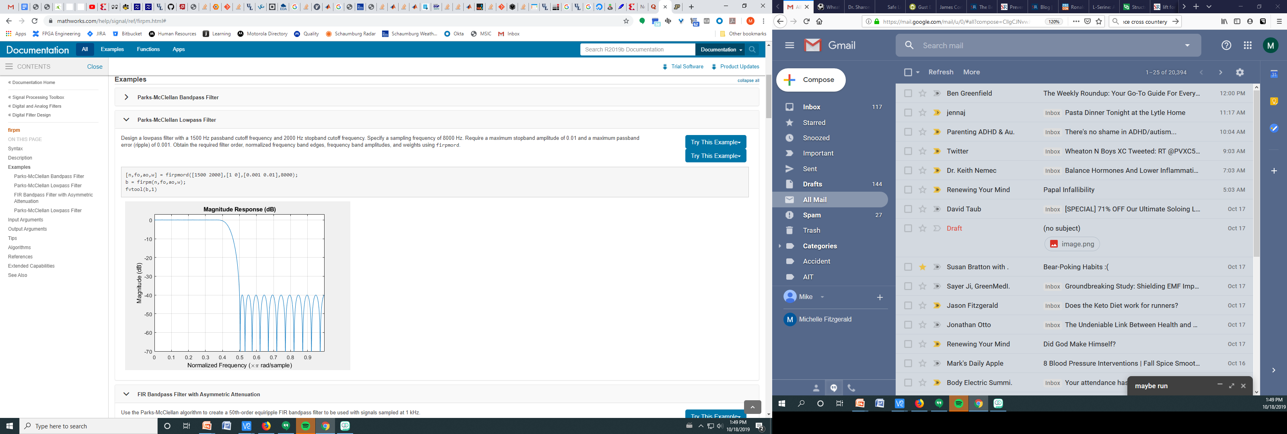
Design a filter with firpm (Parks/McClellan) https://www.mathworks.com/help/signal/ref/firpm.html#
Tag:
Filter design

Slide 38
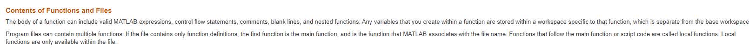
Namespace in a Matlab function
Controlled by
Function arguments
Any load() commands which bring it variables & functions from other workspaces (mat) files
“Any variables that you create within a function are stored within a workspace specific to that function, which is separate from the base workspace.”
Tag:
functions

Slide 39
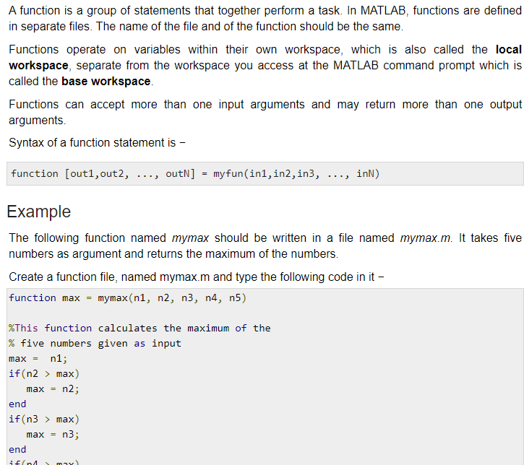
Tutorialspoint on Matlab functions I matlab_functions.htm
functions are defined in separate files. The name of the file and of the function should be the same.
Functions operate on variables within their own workspace, which is also called the local workspace, separate from the workspace you access at the MATLAB command prompt which is called the base workspace.
MTF:
The docs for functions are bad in several ways this is one. In this example the syntax shows an
array [], but the first concrete example shows a single variable.
Tag:
functions

Slide 40
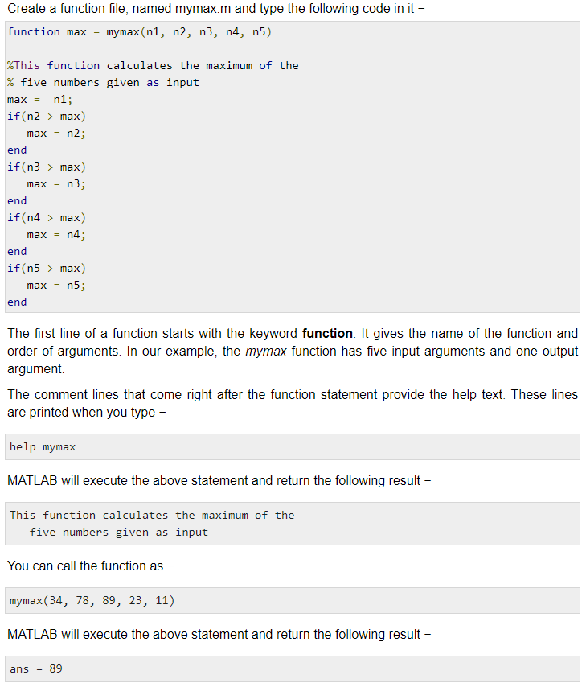
Tutorialspoint on Matlab functions II
Function max has 5 inputs and 1 output arguments
Tag:
functions
Commenting works with help
How to call a function

Slide 41
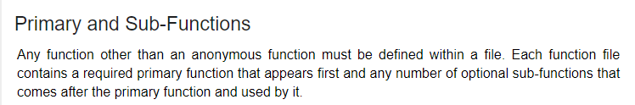
Tutorialspoint on Matlab functions III
It’s not explicitly stated, but a Matlab function file is defined as one that contains only functions. The first function is called the primary function and it needs to be named the same as the file.
The first function is called the primary function and it needs to be named the same as the file.
Other functions in the function file are called secondary functions
Tag:
functions
According to Matlab the must part is not true, as of 2016 functions can be at the end of a script file rather than in a function file.
Just to make it more fun, Octave does not allow functions to be defined at the end of a file
Only in a ‘function file’

Slide 42
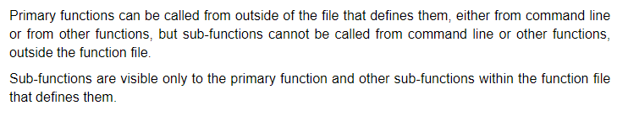
Tutorialspoint on Matlab functions IV
Written nicely!
Tag:
functions

Slide 43

Matlab functions & files
https://www.mathworks.com/help/matlab/matlab_prog/create-functions-in-files.html
Functions defined in a script file can’t be
called in other script files.
Tag:
functions

Slide 44


Octave incompatibility wrt functions
Tag:
Octave incompatibility
Use ‘end’ rather than
‘endfunction’ for Matlab
Octave compatibility

Slide 45


Function: Implicit looping over vector
Simple function, takes one argument, no return value, -> print it.
fprintf used to print to screen only
EXAMPLE, calling the function with an array demonstrates implicit looping
Create a 4 element vector a
Call the function on the a
Matlab implicitly loops over the vector without the user creating a loop
Tag:
Function
Implicit looping

Slide 46




Function : Octave page
link
Tag:
function reference
octave

Slide 47





Function: Examples
Note 1)
If there are return values,
then the ‘=‘ is used
basic
Tag:
function examples
Takes an arg
Note 2)
Interesting there is no type or direction associated with the function args.
Returns one value
Returns multiple values
Returns magnitude and angle

Slide 48

path command, seems like it would be more useful interactive than in a script
Tag:
path
I had previously added the path shown:
>> fpath = 'C:/Users/family/Desktop/bitbucket_stuff/stuff/matlab_examples';
>> fpath
fpath = C:/Users/family/Desktop/bitbucket_stuff/stuff/matlab_examples
These paths are from my family computer at home

Slide 49

addpath command, example
addpath has more options
>> addpath('.\utilities');
>> path
Octave's search path contains the following directories:
.
.\utilities
C:\Octave\<path>\<path>\x86_64-w64-mingw32
>> [a b] = stepseq(2,1,3)
a =
0 1 1
b =
1 2 3
Stepseq is in the utilities folder
Tag:
addpath

Slide 50

If statement, also check if dir exists
Tag:
Check directory exists
If statement

Slide 51

Combination of 3 commands addpath, fullfile, getenv
Tag:
addpath
fullfile
getenv
addpath(fullfile(getenv(‘SOMEVAR'),some_folder'))

Slide 52
Add a path in .m code relative to an environment variable
addpath(fullfile(getenv(‘ENV_VAR_NAME'),‘folder_name'))
Tag:
addpath

Slide 53
Concatenate Strings
>> a = 'foo' a = foo >> b = 'bar' b = bar >> [a b] ans = foobar
Tag:
String concatenation
Put together the entire path to a file

Slide 54

~ is a placeholder to ignore function outputs
example
Tag:
Miscellaneous
tilde

Slide 55




Load and Save commands
Start from a clear workspace
Define a = 1, b = 2
Save the workspace
Clear the workspace
again
Load the saved workspace
Verify the saved variables
Are there.
Tag:
load
save

Slide 56

Command vs Function Syntax
Tag:
Miscellaneous
command & function syntax

Slide 57

Command vs Function Syntax II
Tag:
miscellaneous
command & function syntax

Slide 58
Command vs Function Syntax III
How MATLAB Recognizes Command Syntax
Consider the potentially ambiguous statement
ls ./d
This could be a call to the ls function with the folder ./d as its argument. It also could request element-wise division on the array ls, using the variable d as the divisor.
If you issue such a statement at the command line, MATLAB can access the current workspace and path to determine whether ls and d are functions or variables.
However, some components, such as the Code Analyzer and the Editor/Debugger, operate without reference to the path or workspace.
In those cases, MATLAB uses syntactic rules to determine whether an expression is a function call using command syntax.
In general, when MATLAB recognizes an identifier (which might name a function or a variable),
it analyzes the characters that follow the identifier to determine the type of expression, as follows:
An equal sign (=) implies assignment. For example:
ls =d
An open parenthesis after an identifier implies a function call. For example:
ls('./d')
Space after an identifier, but not after a potential operator, implies a function call using command syntax. For example:
ls ./d
Spaces on both sides of a potential operator, or no spaces on either side of the operator, imply an operation on variables. For example, these statements are equivalent:
ls ./ d ls./d
Therefore, the potentially ambiguous statement ls ./d is a call to the ls function using command syntax.
The best practice is to avoid defining variable names that conflict with common functions, to prevent any ambiguity.
Tag:
miscellaneous
command & function syntax

Slide 59
Plotting
RE-labeling
xticks([-3*pi -2*pi -pi 0 pi 2*pi 3*pi])
xticklabels({'-3\pi','-2\pi','-\pi','0','\pi','2\pi','3\pi'})
https://www.mathworks.com/help/matlab/creating_plots/change-tick-marks-and-tick-labels-of-graph-1.html
- Element by element operation: dot is after the variable A = 1:5; C = A.^2 - Plotting with different lines plot(X,Y,LineSpec) Can change linestyle,marker, color
Tag:
plotting

Slide 60

Plot I Specify Line Style
plot(X1,Y1,LineSpec1,...,Xn,Yn,LineSpecn) sets the line style, marker type,
and color for each line.
You can mix X, Y, LineSpec triplets with X, Y pairs.
x = 0:pi/100:2*pi;
y1 = sin(x);
y2 = sin(x-0.25);
y3 = sin(x-0.5);
figure
plot(x,y1,x,y2,'--',x,y3,':')
Tag:
plot
line style

Slide 61

Plot II Specify Line Style Color and marker
Plot three sine curves with a small phase shift between each line.
Use a green line with no markers for the first sine curve.
Use a blue dashed line with circle markers for the second sine curve.
Use only cyan star markers for the third sine curve.
x = 0:pi/10:2*pi;
y1 = sin(x);
y2 = sin(x-0.25);
y3 = sin(x-0.5);
figure
plot(x,y1,'g',x,y2,'b--o',x,y3,'c*')
Tag:
plot
line style color
marker

Slide 62


Plot III
figure
t = 0:pi/20:2*pi;
subplot(3,2,1)
plot(t,sin(t),'d')
subplot(3,2,2)
plot(t,sin(t),'dr')
subplot(3,2,3)
plot(t,sin(t),'dc')
subplot(3,2,4)
plot(t,sin(t),'-.r*')
subplot(3,2,5)
plot(t,sin(t),'-.r+')
subplot(3,2,6)
plot(t,sin(t),'-.r*')

Slide 63


Plot IV Line Style Markers, and Color
t = 0:pi/20:2*pi;
plot(t,sin(t),'-.r*')
plot(t,sin(t-pi/2),'--mo')
plot(t,sin(t-pi),':bs')

Slide 64


Plot V A gotcha When plotting without a x axis vector, the starting x value is 1
Don’t try to
Change the x axis (don’t
Try to use xlim().
This is just how it works.
Use an x argument
To plot(), that starts at 0.
Started
at x = 1

Slide 65

subplot Create axes in tiled positions subplot
Max digital frequency
pi radians/sample
x = 0:10;
y1 = cos(pi*x);
y2 = cos(pi/2*x);
y3 = cos(pi/4*x);
y4 = cos(pi/6*x);
subplot(4,1,1);
plot(x,y1);
xlabel('Samples');
ylabel('Cos(pi/2*x)');
title('Experiments');
subplot(4,1,2);
plot(x,y2);
subplot(4,1,3);
plot(x,y3);
subplot(4,1,4);
plot(x,y4);
First two args creates
4 row, 1 column grid
Third arg selects the
specific plot on the grid
Tag:
plotting
subplot

Slide 66



xticks 0 definitions
Tag:
Plotting
xticks

Slide 67



Xticks I
Tag:
Plotting
Xticks
example
>> stem(x,y);
>> x = 0:4;
>> y = x;
>> stem(x,y);
>>xticks([0,1]);
>>xticks([1]);
Default ticks

Slide 68

Xticks II
Tag:
Plotting
Xticks
example
The labels are paired with the xticks array
>> xticks([ 1 2 3]);
>> xticklabels({'one', 'two'})
>> x = 0:4;
>> y=x;
>> plot(x,y);
>> xticks([1 2 3]);
>> xticklabels({'one','two'})
Ticks at x=1,2,3
Labels ‘one’ ‘two’ at x= 1,2

Slide 69


Single and Double Quotes
Tag:
quote

Slide 70



Don’t use length() function, rather use size() or numel()
Tag:
length, size
clean

Slide 71
Matlab resources
Lecture notes on sampling, has nice corresponding Matlabs
http://www.eas.uccs.edu/~mwickert/ece2610/lecture_notes/ece2610_chap4.pdf
Matlab tut for the same class
http://www.eas.uccs.edu/~mwickert/ece2610/lecture_notes/ece2610_Append_matlab.pdf
Index of this class
http://www.eas.uccs.edu/~mwickert/ece2610/lecture_notes/
This is neat, seems to have some problems missing vars, some Matlab only no octave
interesting DSP sig process Matlab
Load octave signal package
pkg load signal
Tag:
resources

Slide 72
Load package
Load octave signal package
pkg load signal
Tag:
package
signal
background’s clean up
to and including this slide
from the beginning. 6/1/2021

